Slide 1
Willow Grove Mill
Homeowners Association
Annual Meeting
September 25, 2024

Slide 2


Agenda
Call to Order
President’s Report
Treasurer’s Report
FAQs
Old Business
New Business
Q&A/Adjournment

Slide 3
President’s Report
PayHOA
  New platform for payment and account management.
  Enrollment allows online payment, scheduling of autopayments, statement printing, online billing and email communication.
  Both paper an electronic bills will be sent moving forward
  Enroll at PayHOA.com
Assessment – June 2024
  Bills (587) sent June 9th, due July 9th
  68% compliance rate – 401 paid/186 unpaid
  Late fees billed - $1,088.50

Slide 4
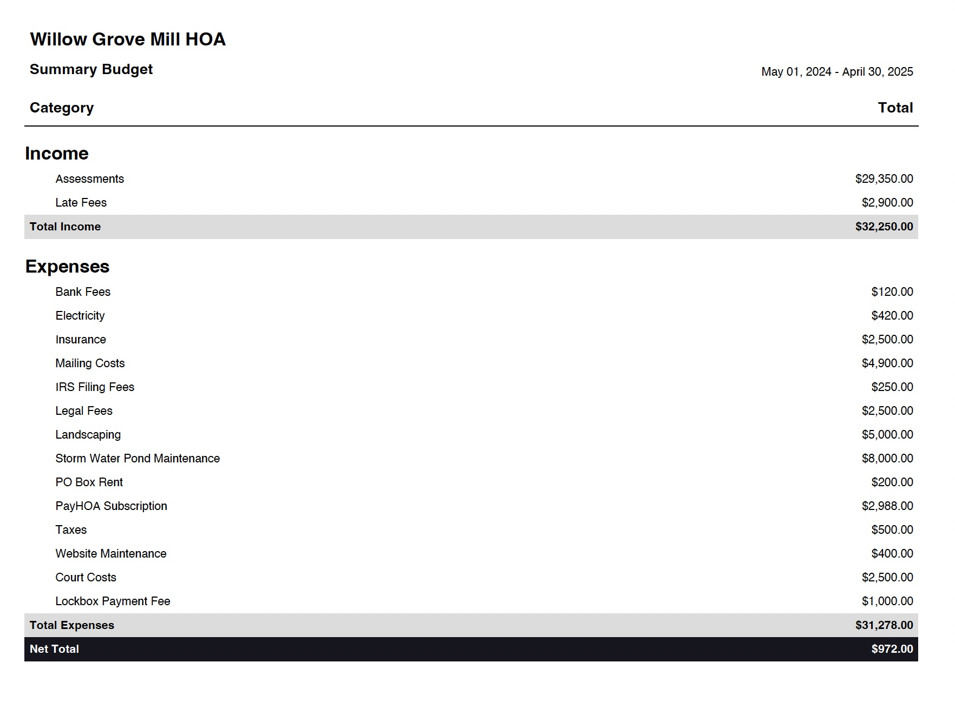
2024 Budget

Slide 5
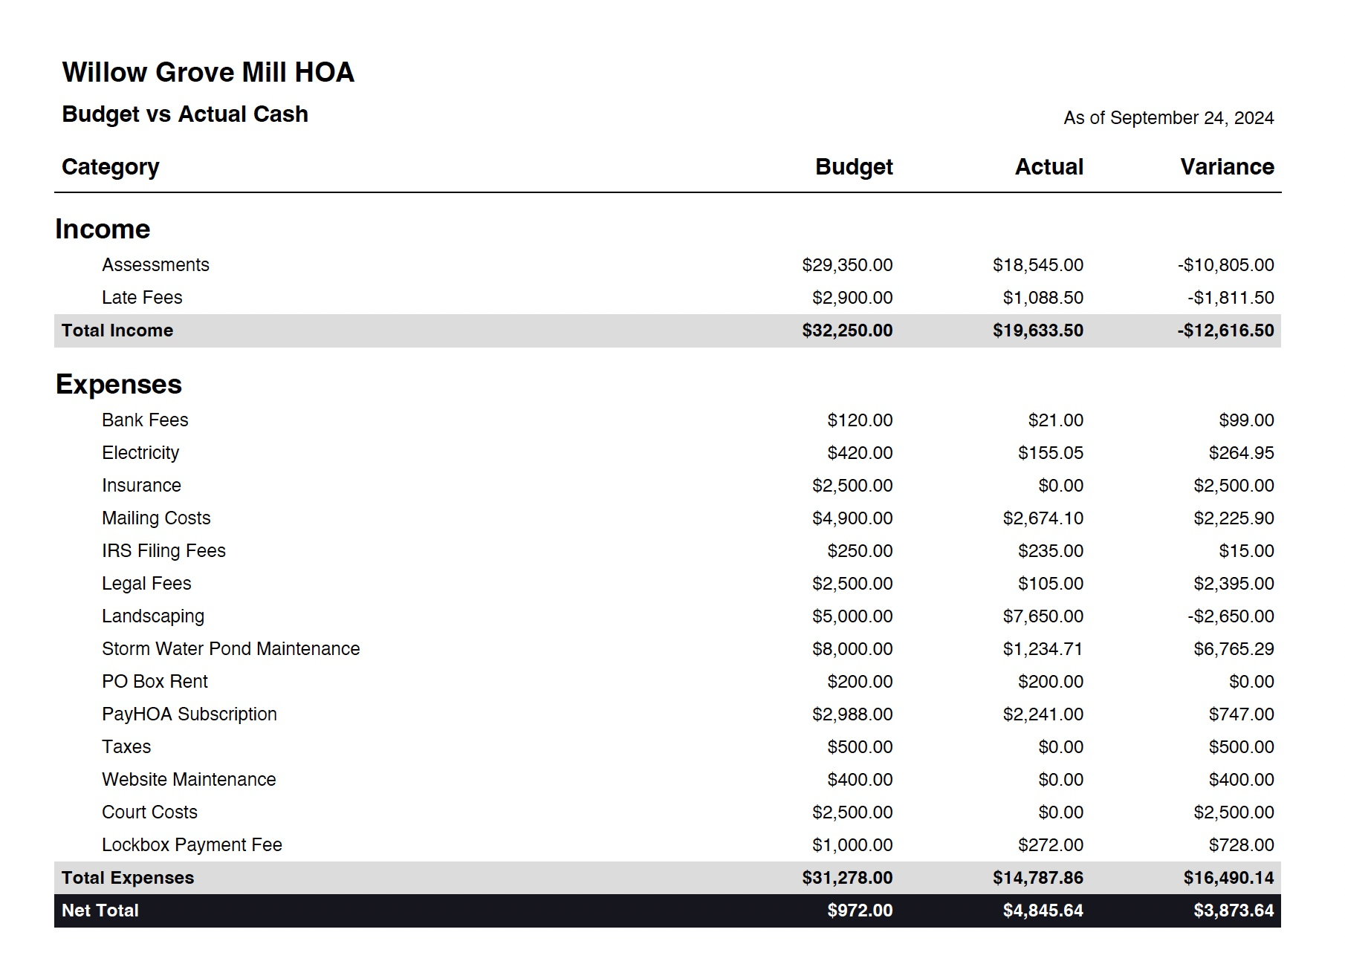
2024 Budget vs. Actual

Slide 6
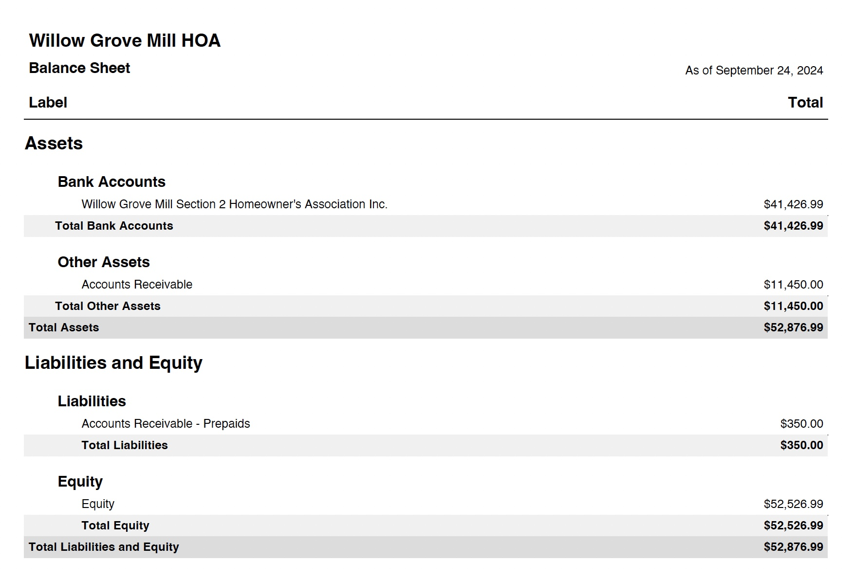
2024 Balance Sheet

Slide 7
Old Business

Slide 8
FAQs:
Arcitecurual Review – Any exterior changes or improvements must ve submitted for approval on our website. This includes, roofs, fences, landscaping, additions, sheds, pools, hot tubs, decks, patios, etc.
Parking:
  No commercial vehicles can be parked overnight on community streets. Includes moving vans, panel trucks, tractor trailers
  Cars Blocking sidewalk – Cars left hanging over the public sidewalk will be ticketed
  Cars blocking driveways on either side of the street
  Cars parked within the intersection
  No Saving Spots – Garbage cans, beach chairs or other item found to be saving spots on non-trash days will be removed
Shoveling – Sidewalks around your property must be shoveled within 48 hours according to Middletown code
Trash Can Storage – Trash cans must be removed from the street within 24 hours
Trailers – No Utility, boat or car trailers can be parked on residential streets or driveways
Auto Repairs cannot be made on the street or in public parking areas
Cleanup after your dog
Tree Trimming – Tree limbs hanging over the street or sidewalk lower than 6 feet must be trimmed

Slide 9
Important Numbers

Slide 10
New Business

Slide 11
Deed Restriction Enforcement
  Fines:
  The board has passed a resolution to implement a fine structure for all deed restriction violations
  Fines will be levied within 30 days if the violation is not addressed and every 15 days thereafter until the violation is resolved.
  Unpaid fines will be referred to JP court for collection, reporting to credit bureaus and eventually liens on the property
  Structure is as follows:
Fine | Restriction/Violation
$50 | Lawn maintenance violations Trash receptacle violations Basketball goal violations Vegetable gardens Tree Trimming Dog cleanup
$100 | Trailers/Campers/RVs Disabled/Unregistered Vehicles
$150 | Fence violations Above-ground swimming pools Outbuilding violations (e.g. oversized sheds) Plan review violations

Slide 12
Q&A/Adjournment
Website: www.willowgrovemillhoa.com
Facebook: Willow Grove Mill HOA
Email: contactus@willowgrovemillhoa.com
ARC Review: arcreview@willowgrovemillhoa.com
Board of Directors
Aaron Blythe, President – 302-685-0173
Joyce Kidd, Vice President – 302-376-6381
Brian Yarborough, Secretary – 302-449-2744
Tony Tagliaferro, Treasurer – 845 913-8327
Jackie Brown, At-large – 856 979-5112

