Slide 1
Willow Grove Mill Homeowners Association
2021 Annual Meeting
February 9, 2022

Slide 2
Agenda
Call to Order
President’s Report
Treasurer’s Report
Architectural Review
Old Business
New Business
Election of Directors – If Necessary
Q&A/Adjournment

Slide 3
President’s Report
Assessment – May 2021
Bills (587) sent May 31st, due June 30th
2021 – 75% compliance rate – 441 paid/146 unpaid
2020 – 69% compliance rate – 183 unpaid)
Inquiries 2021 (website, phone, mail, email) – 143 Total (2021 -175)
Deed Restrictions/ARC review questions
Dues/Budget/Mailing Address/Delinquent notices/Check cashed
Real estate closing agents/Attorneys/Insurance
Nuisance (Dogs, Property lines, Property maintenance, Mowing)
Other (Callbacks, requests for info)
Traffic/Parking/Roads/Vehicles

Slide 4
Treasurer’s Report – 2021 Update

Slide 5
Treasurer’s Report – Proposed 2022

Slide 6
Architectural Review

Slide 7
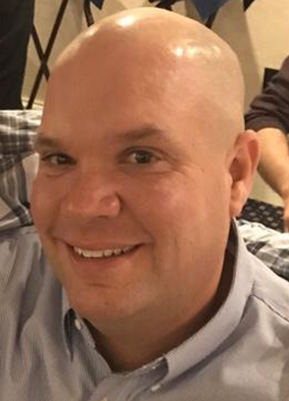
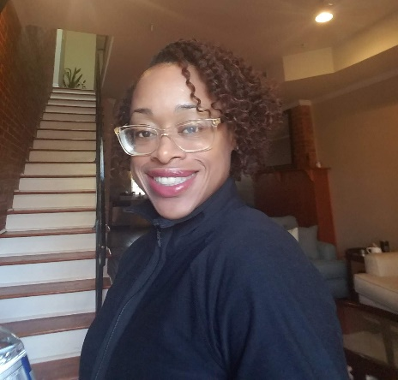
Willow Grove Mill Architectural Review Committee
Tom Peters
Chairperson
Richard Harding
Nicole Homer

Slide 8
Purpose of Architectural Review Committee
Review applications / requests for changes to residential property
Post – approval follow-up to ensure compliance with original submission
May investigate potential complaints of violations w/ Board of Directors

Slide 9
Requests requiring ARC approval
Outbuildings (sheds, gazebos, outdoor storage facility, etc…)
Decks, porches, patios & other additions
Swimming Pools
Permanent Firepits
Fences
Exterior mechanical devices

Slide 10
Architectural review process
Submit application and all associated building plans to ARC
Can be submitted via WGM HOA website (www.willowgrovemillhoa.com)
Committee to review application & documentation
Committee to respond within 14 days with decision or clarifying questions
If approved, plans & approval to be submitted to Town of Middletown for an application for a building permit
ARC approval does NOT supersede Town of Middletown Approval
Changes to plans must be re-submitted to ARC for re-approval.

Slide 11
What THE ARC LOOKS for
Compliance with deed restrictions
Aesthetic suitability
Effect on neighboring properties & neighborhood

Slide 12
Questions?

Slide 13
Old Business

Slide 14
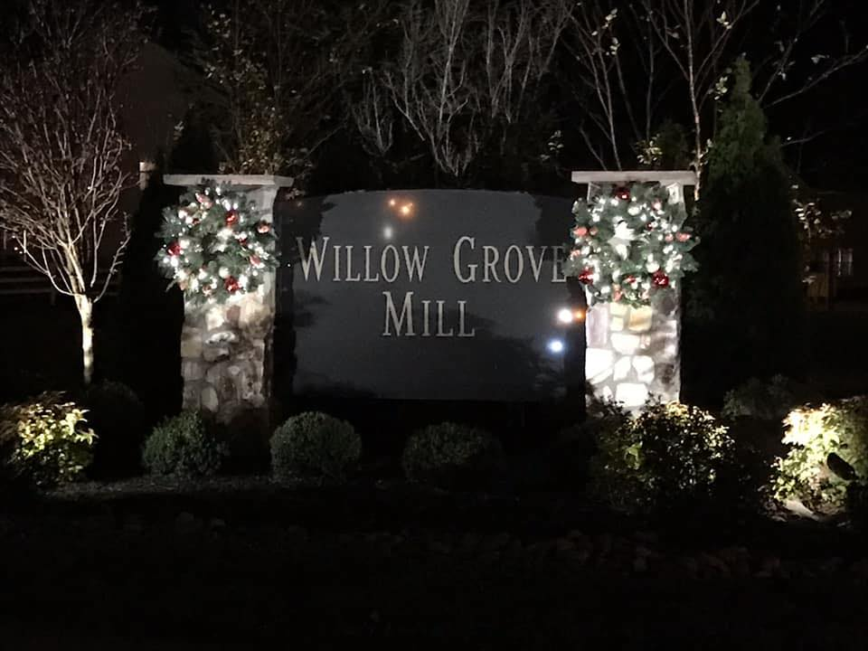
2021 Initiatives
Holiday Wreaths

Slide 15
General Reminders
Parking:
No commercial vehicles can be parked overnight on community streets. Includes moving vans, panel trucks, tractor trailers
Cars Blocking sidewalk – Cars left hanging over the public sidewalk will be ticketed
Cars blocking driveways on either side of the street
Cars parked within the intersection
No Saving Spots – Garbage cans, beach chairs or other item found to be saving spots on non-trash days will be removed
Shoveling – Sidewalks around your property must be shoveled within 48 hours according to Middletown code
Trash Can Storage – Trash cans must be removed from the street within 24 hours
Trailers – No Utility, boat or car trailers can be parked on residential streets or driveways
Auto Repairs cannot be made on the street or in public parking areas
Cleanup after your dog
Tree Trimming – Tree limbs hanging over the street or sidewalk lower than 6 feet must be trimmed

Slide 16
Important Numbers

Slide 17
New Business

Slide 18
2022 Initiatives
East Truepenny and Gloucester Tree Replacement
Deed Restriction Revisions Implementation
Increase to Shed Sizes
Fines Structure
Fences
Reduction to Quorum
Property Type | Lot Size | Shed Size
Single Family | 1/8 acre to 1/4 acre | Up to 12x12
Single Family | 1/4 acre to 1/3 acre | Up to 12x14
Single Family | >1/3 acre | Up to 12x16
Townhomes* | All lot Sized | Up to 8x10
*All townhome lit sizes in WGM restrict shed sized to 80 sq ft due to Town setback requirements

Slide 19
Middletown Police Updates
87 calls for MPD service to WGM YTD (as of 12/16/2021)
15 property check calls (18%)
13 vehicle stops (15%)
11 suspicious vehicles (13%)
5 parking violations (6%)
WGM calls for service are on the lower end of total calls YTD 2021 in Middletown
Crimes in the community are largely committed by non-residents of WGM
Theft from/of motor vehicles the largest driver of calls
Residents encouraged to lock your vehicles, remove keys, and do not leave valuables inside
Crime trends are largely coming form suspects in Wilmington and are county wide issues
Delaware Crime Stoppers is another resource to report crimes anonymously. Tips can be reported anonymously here: https://www.p3tips.com/tipform.aspx?ID=346&CX=040404

Slide 20
Community Updates
New Appoquinimink Library – Silver Lake Park – Fall 2022
DE-299 Widening (SR1 to Catherine St) – Completion Fall 2023
Middletown YMCA – Silver Lake Park – 2024/2025
NCC Regional Park – Shallcross Lake Road – 2024

Slide 21
Springfield Fire
Fire damaged 4 units on the 100 block of Springfield Circle
Cause under investigation
4 families displaced
Family | Address | Phone | Family members | Needs | GoFundMe
Jefferson Family | 132 Springfield | 609-424-6566 | 2 adults, 12 year old | Food, clothing and personal items | https://gofund.me/7aab81d6
Bascone/Zell Family | 134 Springfield | 302-660-1898 | 2 adults/2 dogs (50lbs) | Temporary housing that accepts dogs | https://gofund.me/79e21b99
TBD | 136 Springfield | - | - | - | -
Campbell Family | 138 Springfield | 215-626-5789 | 2 adults/4 children ages 10, 15, and infant twins) | Clothing, sneakers, coat for ages 10 & 15; Bottles, wipes, pacifiers, strollers, anything baby | https://gofund.me/9865bcc4

Slide 22
Election of Directors
The community elects up to five directors each year
Written nominations solicited in advance by mail or email (due 2/8/22)
Quorum of 176 homes (30%) is required to hold election
If no quorum exists, current directors remain in place until next election
If fewer than 6 nominations, all nominated directors are appointed to the board without an election
No write-ins permitted
Vote determines the directors who will sit on the board. Specific officer positions are voted on by the board itself once elected.
Nominees- Received 5 total nominations:
Aaron Blythe – Current President
Joyce Kidd – Current Vice President
Tony Tagliaferro – Current Treasurer
Brian Yarborough – Current Secretary
Jackie Brown – Current At-large Member

Slide 23
Q&A/Adjournment
Website: www.willowgrovemillhoa.com
Facebook: Willow Grove Mill HOA
Email: contactus@willowgrovemillhoa.com
ARC Review: arcreview@willowgrovemillhoa.com
Board of Directors
Aaron Blythe, President – 302-378-7850
Joyce Kidd, Vice President – 302-376-6381
Brian Yarborough, Secretary – 302-449-2744
Tony Tagliaferro, Treasurer – 845 913-8327
Jackie Brown, At-large – 856 979-5112

