Slide 1
Willow Grove Mill
Homeowners Association
2020 Annual Meeting
February 3, 2021

Slide 2


Agenda
Call to Order
President’s Report
Treasurer’s Report
Architectural Review
Old Business
New Business
Election of Directors – If Necessary
Q&A/Adjournment

Slide 3
President’s Report
Assessment – May 2020
  Bills (587) sent May 30th, due June 30th
  69% compliance rate – 405 paid/183 unpaid (2018 – 75% compliance rate – 145 unpaid)
Inquiries 2020 (website, phone, mail, email) – 175 Total (2019 -156)
  Deed Restrictions/ARC review questions
  Dues/Budget/Mailing Address/Delinquent notices/Check cashed
  Real estate closing agents/Attorneys/Insurance
  Nuisance (Dogs, Property lines, Property maintenance, Mowing)
  Other (Callbacks, requests for info)
  Traffic/Parking/Roads/Vehicles

Slide 4
Treasurer’s Report – 2020 Update

Slide 5
Treasurer’s Report – Proposed 2021

Slide 6
Architectural Review
Nicole Homer

Slide 7

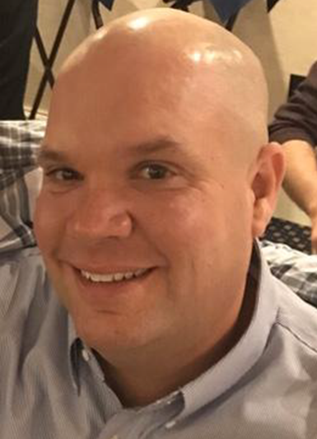
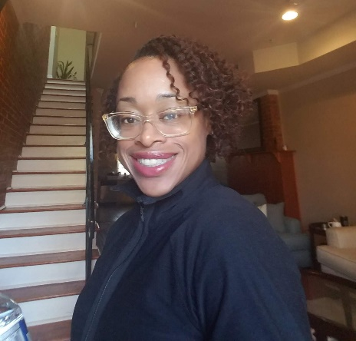
Willow Grove Mill
Architectural Review Committee
Tom Peters
Chairperson
Richard Harding
Nicole Homer

Slide 8
Purpose of Architectural Review Committee
Review applications / requests for changes to residential property
Post – approval follow-up to ensure compliance with original submission
May investigate potential complaints of violations w/ Board of Directors

Slide 9
Requests requiring ARC approval
Outbuildings (sheds, gazebos, outdoor storage facility, etc…)\
Decks, porches, patios & other additions
Swimming Pools
Permanent Firepits
Fences
Exterior mechanical devices

Slide 10
Architectural review process
Submit application and all associated building plans to ARC
  Can be submitted via WGM HOA website (www.willowgrovemillhoa.com)
Committee to review application & documentation
Committee to respond within 14 days with decision or clarifying questions
If approved, plans & approval to be submitted to Town of Middletown for an application for a building permit
  ARC approval does NOT supersede Town of Middletown Approval
Changes to plans must be re-submitted to ARC for re-approval.

Slide 11
What THE ARC LOOKS for
Compliance with deed restrictions
Aesthetic suitability
Effect on neighboring properties & neighborhood

Slide 12
Questions?

Slide 13
Old Business

Slide 14
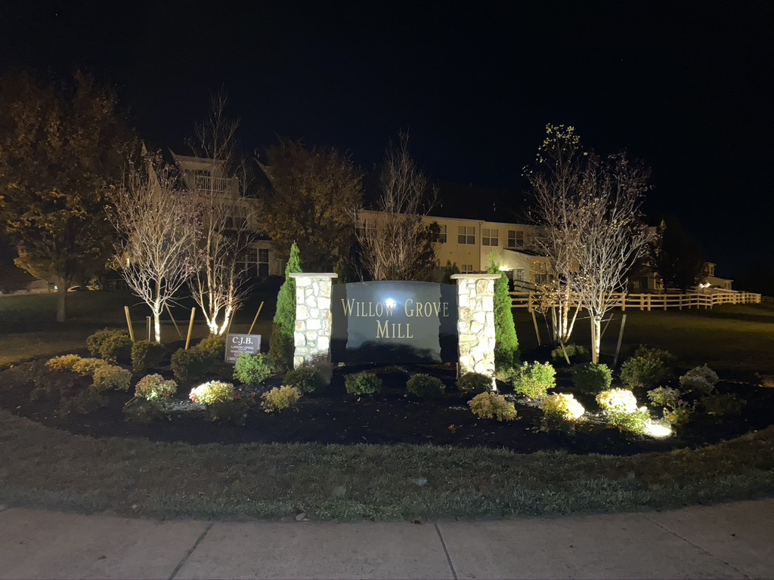
2020 Initiatives
Entry Sign Landscape Project

Slide 15
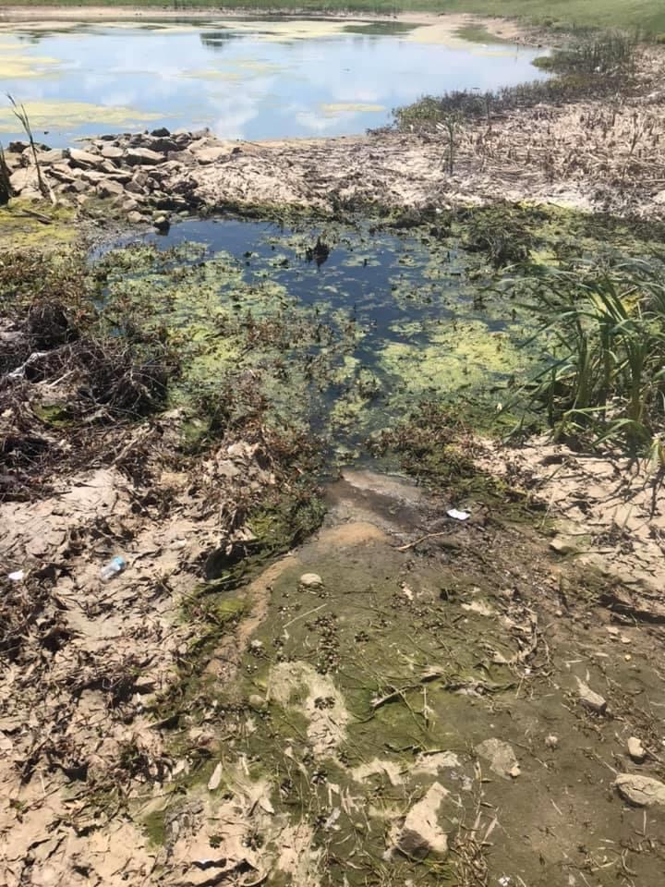
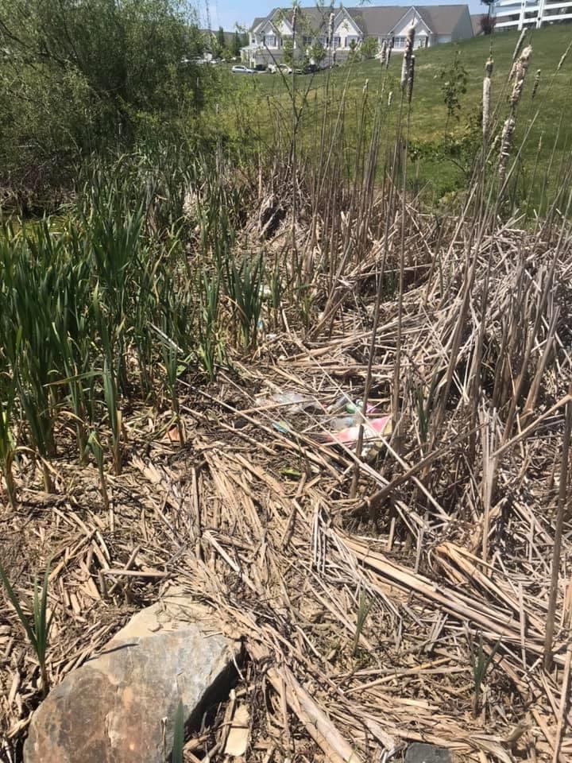
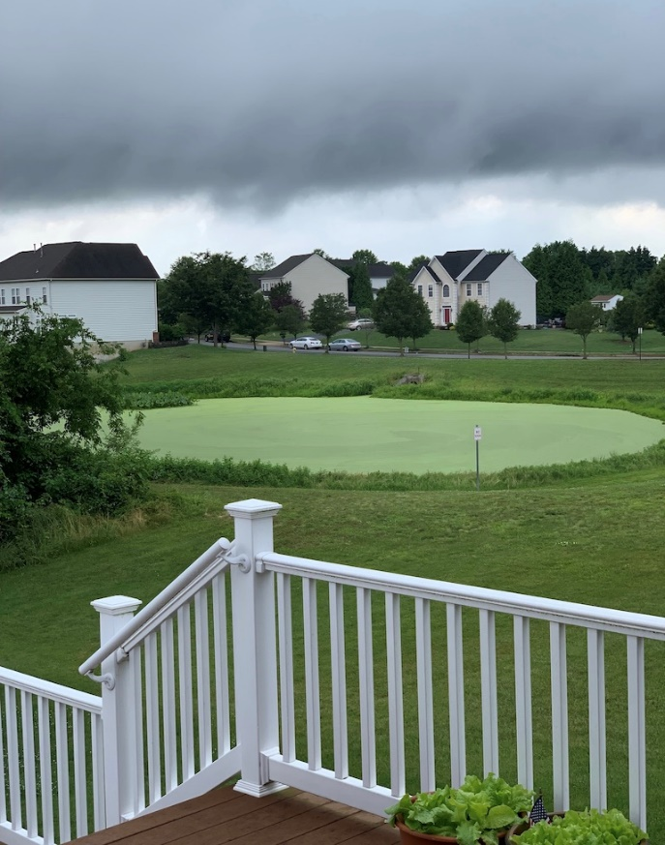
2020 Initiatives
Storm water Pond Algae Remediation Project
Envirotech will provide monthly pond maintenance (Mar-Nov)
  Algae Treatments
  Maintenance of vegetation, buffers, and trash removal
  Introduction of mosquito fish

Slide 16
2020 Initiatives
Deed Restriction Review Committee
Committee formed last summer to review current deed restrictions and recommend additions, changes, or deletions
Committee comprised of four residents:
  Tom Peters – Chairperson
  Mandy Catalfamo
  Nicole Homer
  John Lose
  John Mastalski
Draft recommendations have been submitted to the board for review
Final recommendations be approved by board early spring
Final changes will be presented to the community spring/summer

Slide 17
General Reminders
Parking:
  No commercial vehicles can be parked overnight on community streets. Includes moving vans, panel trucks, tractor trailers
  Cars Blocking sidewalk – Cars left hanging over the public sidewalk will be ticketed
  Cars blocking driveways on either side of the street
  Cars parked within the intersection
  No Saving Spots – Garbage cans, beach chairs or other item found to be saving spots on non-trash days will be removed
Shoveling – Sidewalks around your property must be shoveled within 48 hours according to Middletown code
Trash Can Storage – Trash cans must be removed from the street within 24 hours
Trailers – No Utility, boat or car trailers can be parked on residential streets or driveways
Auto Repairs cannot be made on the street or in public parking areas
Cleanup after your dog
Tree Trimming – Tree limbs hanging over the street or sidewalk lower than 6 feet must be trimmed

Slide 18
New Business

Slide 19
2021 Initiatives
Open Space, East Truepenny and Gloucester Tree Replacement
Deed Restriction Revisions Implementation

Slide 20
Community Updates
New Appoquinimink Library – Silver Lake Park – 2021
DE-299 Widening Project (SR1 to Catherine St) – 2022
Middletown YMCA – Silver Lake Park – 2024
NCC Regional Park – Shallcross Lake Road – 2024
Panera Bread – Fall 2021
Agave - TBD

Slide 21
Middletown Police Updates
Chief Kracyla retired December 31st
Acting Chief, Captain Texter implementing changes to the patrol structure for Middletown
  Town will continue to emphasize community policing
  Town will be divided into four patrol sectors (WGM is within Sector 4)
  Specific Officers will be dedicated to Zone 4 to support WGM
  Residents will be able to email these officers directly to address specific needs
  Board will be partnering with these officers and will have them available at a future meeting once the new patrol structure is finalized.

Slide 22
Election of Directors
The community elects up to five directors each year
Written nominations solicited in advance by mail or email (due 1/28/20)
Quorum of 176 homes (30%) is required to hold election
If no quorum exists, current directors remain in place until next election
If fewer than 6 nominations, all nominated directors are appointed to the board without an election
No write-ins permitted
Vote determines the directors who will sit on the board. Specific officer positions are voted on by the board itself once elected.
Nominees- Received 5 total nominations:
  Aaron Blythe – Current President
  Joyce Kidd – Current Vice President
  Tony Tagliaferro – Current Treasurer
  Brian Yarborough – Current Secretary
  Jackie Brown – Current At-large Member

Slide 23
Q&A/Adjournment
Website: www.willowgrovemillhoa.com
Facebook: Willow Grove Mill HOA
Email: contactus@willowgrovemillhoa.com
ARC Review: arcreview@willowgrovemillhoa.com
Board of Directors
Aaron Blythe, President – 302-378-7850
Joyce Kidd, Vice President – 302-376-6381
Brian Yarborough, Secretary – 302-449-2744
Tony Tagliaferro, Treasurer – 845 913-8327
Jackie Brown, At-large – 856 979-5112

