Slide 1
Willow Grove Mill Homeowners Association
2019 Annual Meeting
January 29, 2020

Slide 2
Agenda
Call to Order
President’s Report
Treasurer’s Report
Architectural Review
Old Business
New Business
Election of Directors – If Necessary
Vote on Deed Restriction Updates
Q&A/Adjournment

Slide 3
President’s Report
Assessment – May 2019
Bills (587) sent May 30th, due June 30th
76% compliance rate – 442 paid/145 unpaid (2018 – 75% compliance rate – 148 unpaid)
Inquiries 2019 (website, phone, mail, email) – 156 Total (2018 -177)
Deed Restrictions/ARC review questions
Dues/Budget/Mailing Address/Delinquent notices/Check cashed
Real estate closing agents/Attorneys/Insurance
Nuisance (Dogs, Property lines, Property maintenance, Mowing)
Other (Callbacks, requests for info)
Traffic/Parking/Roads/Vehicles

Slide 4
Treasurer’s Report – 2019 Update

Slide 5
Treasurer’s Report – Proposed 2020

Slide 6
Architectural Review
Tom Peters

Slide 7
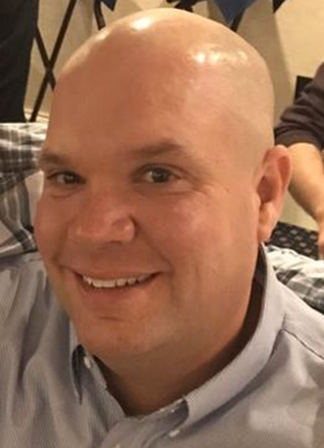
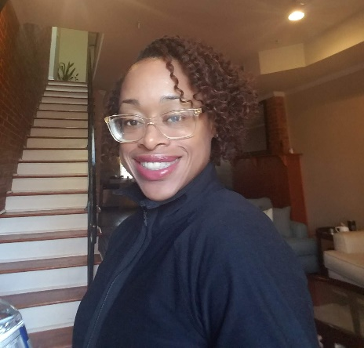
Willow Grove Mill Architectural Review Committee
Tom Peters
Chairperson
Richard Harding
Nicole Homer

Slide 8
Purpose of Architectural Review Committee
Review applications / requests for changes to residential property
Post – approval follow-up to ensure compliance with original submission
May investigate potential complaints of violations w/ Board of Directors

Slide 9
2019 summary
6 formal requests since June 2019
4 approved
1 denied
1 cancelled
2 inquiries owner failed to submit formal request

Slide 10
Requests requiring ARC approval
Outbuildings (sheds, gazebos, outdoor storage facility, etc…)
Decks, porches, patios & other additions
Swimming Pools
Permanent Firepits
Fences
Exterior mechanical devices

Slide 11
Architectural review process
Submit application and all associated building plans to ARC
Can be submitted via WGM HOA website (www.willowgrovemillhoa.com)
Committee to review application & documentation
Committee to respond within 14 days with decision or clarifying questions
If approved, plans & approval to be submitted to Town of Middletown for an application for a building permit
ARC approval does NOT supersede Town of Middletown Approval
Changes to plans must be re-submitted to ARC for re-approval.

Slide 12
What THE ARC LOOKS for
Compliance with deed restrictions
Aesthetic suitability
Effect on neighboring properties & neighborhood

Slide 13
Questions?

Slide 14
Old Business

Slide 15
General Reminders
Parking:
No commercial vehicles can be parked overnight on community streets. Includes moving vans, panel trucks, tractor trailers
Cars Blocking sidewalk – Cars left hanging over the public sidewalk will be ticketed
Cars blocking driveways on either side of the street
Cars parked within the intersection
No Saving Spots – Garbage cans, beach chairs or other item found to be saving spots on non-trash days will be removed
Shoveling – Sidewalks around your property must be shoveled within 48 hours according to Middletown code
Trash Can Storage – Trash cans must be removed from the street within 24 hours
Trailers – No Utility, boat or car trailers can be parked on residential streets or driveways
Auto Repairs cannot be made on the street or in public parking areas
Cleanup after your dog
Tree Trimming – Tree limbs hanging over the street or sidewalk lower than 6 feet must be trimmed

Slide 16
New Business

Slide 17
New Business – 2020 Initiatives
Facebook Business Advertising Page
Storm water Pond Algae Remediation Project
Open Space and East Truepenny Tree Replacement
Increased Deed Restriction Enforcement
Parking
Trampolines
Tree Trimming
Deed Restriction Update

Slide 18
Community Updates
Town-wide Street Sign Upgrades – Ongoing
New Appoquinimink Library – Silver Lake Park – 2021
DE-299 Widening Project (SR1 to Catherine St) – 2022
Middletown YMCA – Silver Lake Park – 2022
NCC Regional Park – Shallcross Lake Road – 2024

Slide 19
Election of Directors
The community elects up to five directors each year
Written nominations solicited in advance by mail or email (due 1/28/20)
Quorum of 176 homes (30%) is required to hold election
If no quorum exists, current directors remain in place until next election
If fewer than 6 nominations, all nominated directors are appointed to the board without an election
No write-ins permitted
Vote determines the directors who will sit on the board. Specific officer positions are voted on by the board itself once elected.
Nominees- Received 6 total nominations:
Aaron Blythe – Current President
Joyce Kidd = Current Vice President
Tony Tagliaferro – Current Treasurer
Brian Yarborough – Current Secretary
Jackie Brown – Current At-large Member
Anthony Yates – New Nominee

Slide 20
Vote - Deed Restriction Changes
Four proposed amendments to the Declaration of Restrictions
Approval of changes must be approved by two-thirds of the community of 392 homes
Votes can be in person or by proxy
Tonight’s votes will be tallied along with proxies from a future door to door campaign to get us to the two-thirds requirement
Summary of proposed updates:
ARTICLE IV: Enforcement – Implementation of a fines structure. Violations of restrictions will be enforced through a fines structure that will assess penalties while the violation remains. Fines will be enforced though liens against the property to help offset legal expenses
ARTICLE VI: Section 7. Prohibited Vehicles - Unregistered vehicles cannot be maintained on any property or street. Update further restricts the use of dirt bikes, motor scooters, trail bikes, ATVs, go-karts, snow mobiles and similar vehicles from being operated/kept on driveways and streets.
ARTICLE VI: Section 17. Outbuildings. Increase to the allowable shed size from 80 sq. ft. to 120 sq. ft. for single family homes only. Townhomes will still be limited to 80 sq. ft.
ARTICLE VI: Section 22. Nuisances Prohibited. New restriction addressing noise, hazardous chemicals, manure, refuse, yard debris, unsafe or damaged lawn/play/sports equipment, or material and debris associated with construction, landscaping, routine automotive repair/storage, or utility installation/replacement.

Slide 21
Q&A/Adjournment
Website: www.willowgrovemillhoa.com
Facebook: Willow Grove Mill HOA
Email: contactus@willowgrovemillhoa.com
ARC Review: arcreview@willowgrovemillhoa.com
Board of Directors
Aaron Blythe, President – 302-378-7850
Joyce Kidd, Vice President – 302-376-6381
Brian Yarborough, Secretary – 302-449-2744
Tony Tagliaferro, Treasurer – 845 913-8327
Jackie Brown, At-large – 856 979-5112

